Slide 1



SWM(Sport With Me)
Presented by Tamar Ravzashvilli, Roey Biton and Ori Ariel

Slide 2

SWM(Sport With Me)
The benefits of participating in group sports:
There are several advantages to participating in sports as a group:
Improved physical fitness.
Social interaction and building friendships.
Stress relief and improved mental health.
Fun and enjoyment.
Team building and communication skills development.
That's some of the reasons we've decided to build SWM!

Slide 3
SWM(Sport With Me)
Introduction to SWM App:
A friendly app that connects users to participate in sports activities together.
Easy sports connection between users.
Host opens an activity of their choice (date, time, and activity).
Guest selects activity of their choice through a simple search on their profile page.
No worries if an activity needs to be cancelled, Host can cancel, and users will receive an email notification about it.

Slide 4
SWM(Sport With Me)
User Experience with our App:
The App UI is designed to be straightforward to use.
Features such as easy activity search and selection, and notification for canceled activities, enhance user experience.
Ultimately, it is up to individual users to decide if the App UI meets their needs and preferences.

Slide 5
SWM(Sport With Me)
Main System Requirements:
Click "Create an Activity“.
Click "Join an Activity“.
Click "Log In" button on main page.
Click " Register " button on main page.
Activity search feature.
Activity information after joining or creating.
24/7 availability (running on Firebase Cloud).
80%+ mobile device compatibility.
Minimized screens for easy navigation.
User-friendly interface.
Now let's showcase the experience on the app for the Hosts and the Guests!

Slide 6
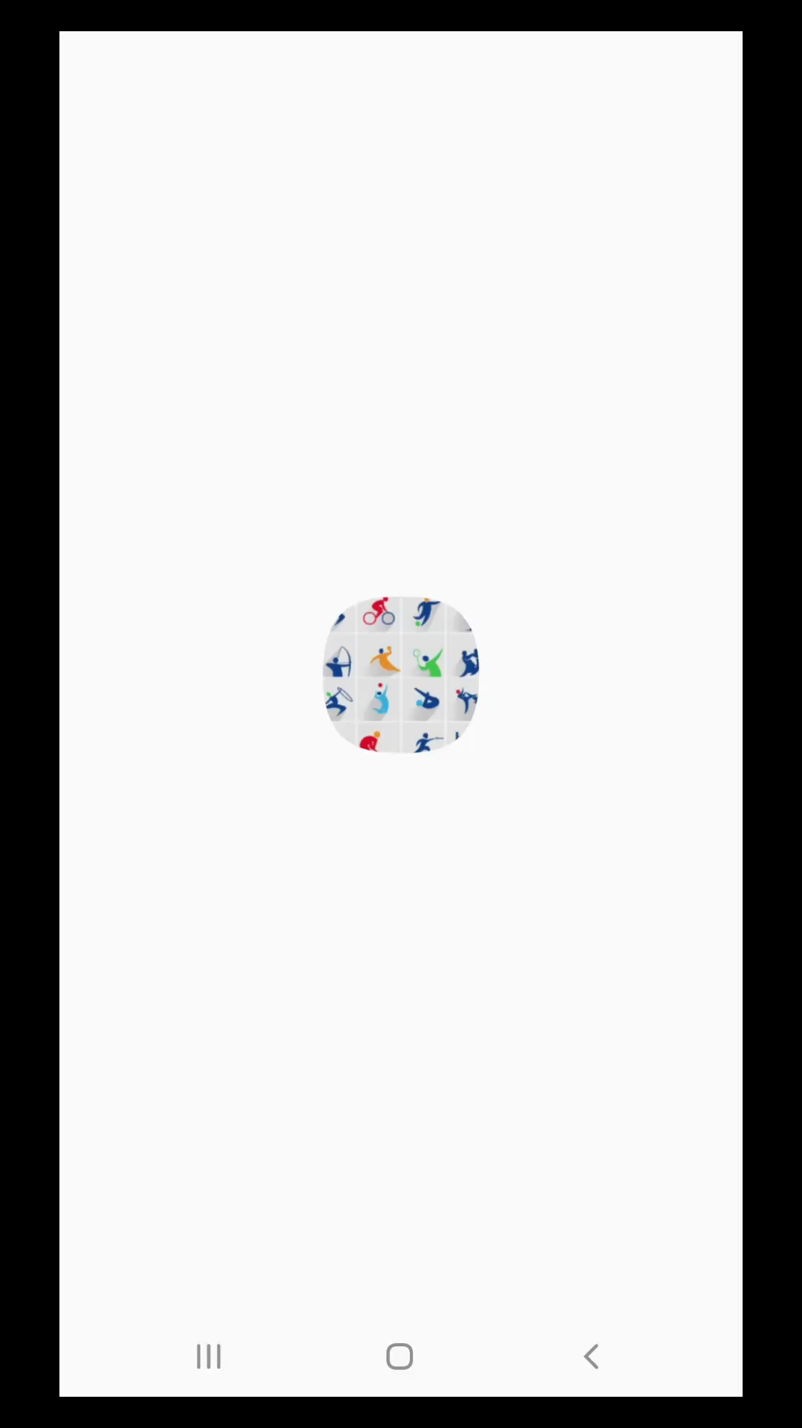
SWM(Sport With Me)
Host showcase:

Slide 7
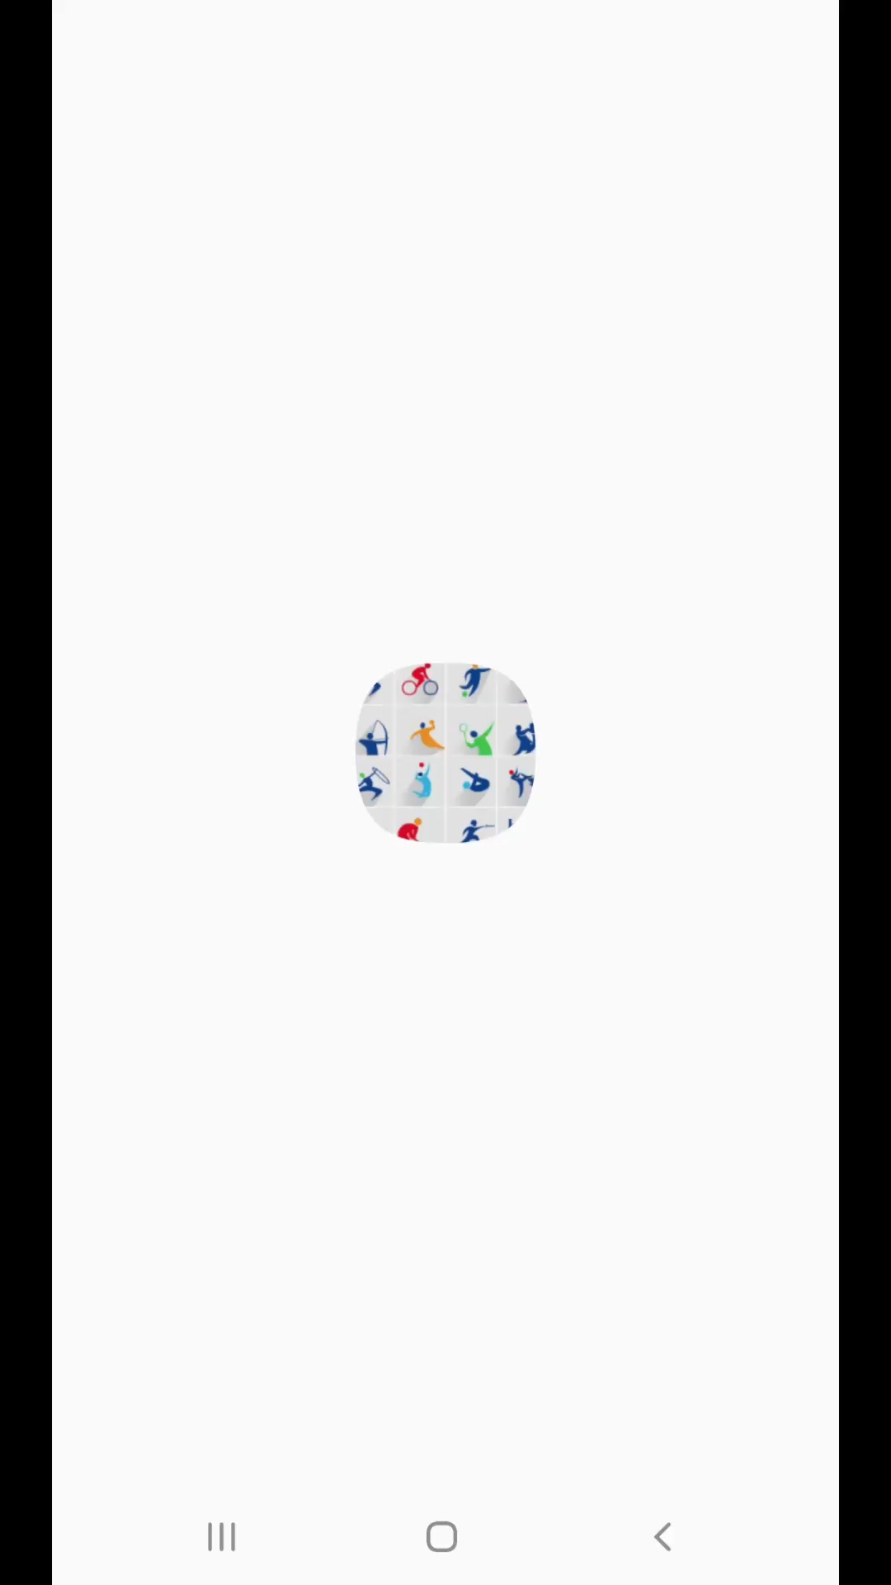
SWM(Sport With Me)
Guest showcase:

Slide 8
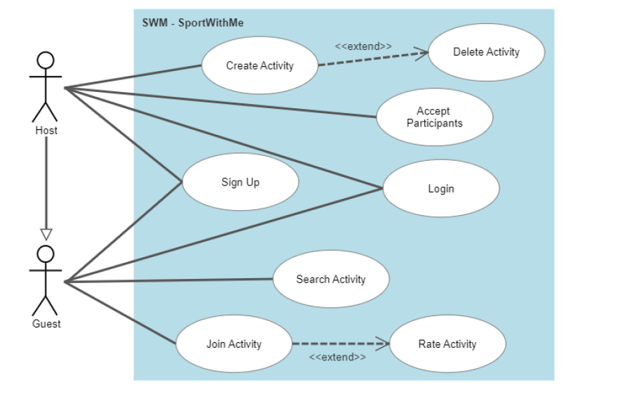
SWM(Sport With Me)
Understanding User Journeys with our Use Case Diagram:
Illustrates the paths taken by two types of users on our app.
Shows the steps they take and the interactions they have with the system.
Helps identify opportunities to improve the user experience and make the app more effective for our users.

Slide 9
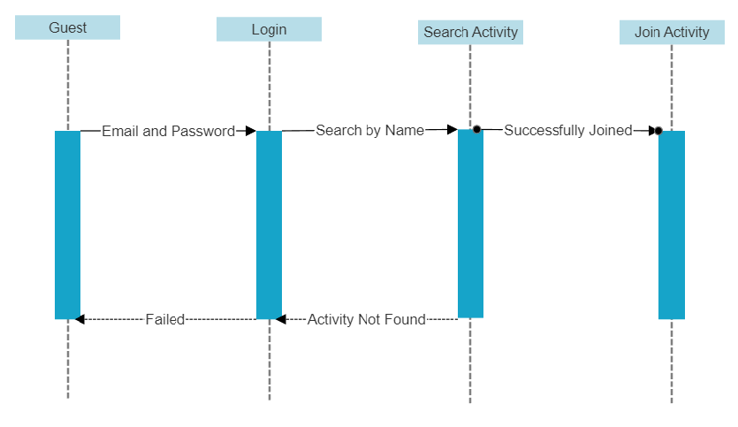
SWM(Sport With Me)
Understanding the User Process with our Sequence Diagram:
Illustrates the process that Guest user go through when using our app.
Helps understand how users interact with the system and identify opportunities for improvement.

Slide 10
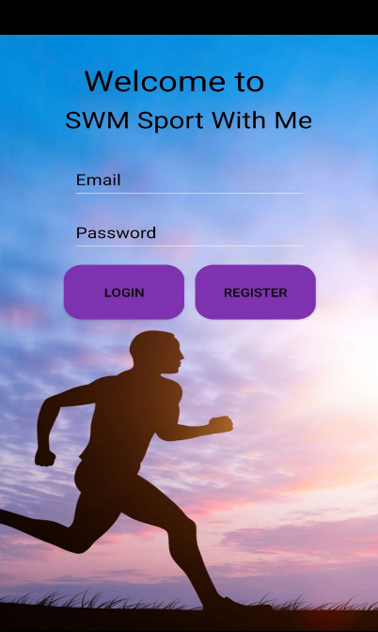
SWM(Sport With Me)
Understanding our Software System and Tech Map:
Our software system has two main tiers: frontend and backend.
The frontend is the interface that users interact with, designed using Android Studio and XML.
The backend handles the data and logic, written in Java, and connects the app screens.
We use Firebase platform as our database to store and organize data such as user accounts, activities, and other relevant information.

Slide 11
SWM(Sport With Me)
Notes:
Although we had several ideas for additional features, we were unable to implement them due to time constraints rather than any technical limitations. These include:
User reviews for activities
Host approval for activity joiners
Integration with Google Maps

Slide 12
SWM(Sport With Me)
Thanks for your time from the SWM team!

